Slide 1
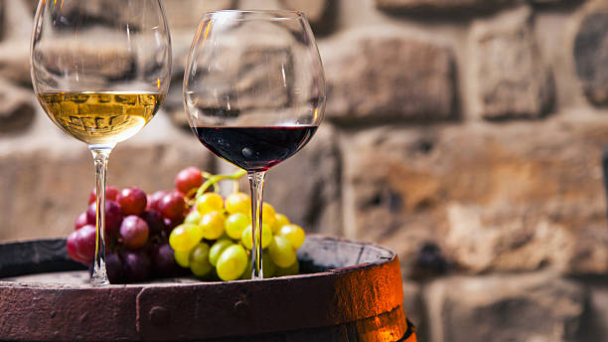
Wine QUALITY
PREDICTION
Precision in Every Sip

Slide 2
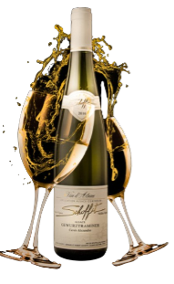
tEAM
DIVYA DATTATRAY SAKHARE
SRAVYA KALLURI
NOOR AHAMED VEMPALLE
NIKIL VALUSA

Slide 3
BUSINESS PROBLEM
The wine industry is facing increasing competition from both domestic and international producers.
Consumers are demanding higher quality wines at a lower price.
Wineries need to be able to produce consistently high-quality wines in order to meet consumer demand and remain competitive.

Slide 4
PAST WORK
Classification vs. Regression
Researchers have addressed this by using regression and classification, accurately predicting wine quality scores and categorizing wines as "good" or "not good" with a common cutoff, often around seven or higher.​
Data Transformation
Categorizing wines as "good" or "not good," as suggested in the tips, simplifies the problem and enhances its suitability for machine learning methods.​
Workflow
Data reading, exploratory data analysis (EDA), data transformation, feature selection, data splitting, and Decision Tree modeling are all included in the recommended procedure. The performance of the model is then assessed using the ROC curve.​​

Slide 5
CITATION OF PRIOR RESEARCH
The provided reference to the work of P. Cortez, A. Cerdeira, F. Almeida, T. Matos, and J. Reis in Decision Support Systems, Elsevier, 47(4):547-553, 2009, suggests that prior research in the field of wine quality prediction using this dataset exists and should be referenced.
In summary, data scientists and researchers have been interested in the "Vinho Verde" wine dataset and have investigated regression and classification techniques for predicting wine quality. While having certain limitations, the dataset provides insightful information about the connection between wine quality and physicochemical characteristics, and it has been utilized to test and assess machine learning models.

Slide 6
DATA
Two datasets are included, related to red and white vinho verde wine samples, from the north of Portugal.
RED WINE
WHITE WINE
Above two datasets are merged adding one extra column as type of wine
11 Feature variables and quality of wine as target variable

Slide 7
MODELS
Below models were used to test
Random Forest Classifier
Logistic Regression
Linear Discriminant Analysis
k-Nearest Neighbors
Classification and Regression Trees(Decision Tree Classifier)
Naive Bayes
Support Vector Machine

Slide 8

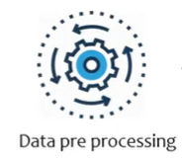
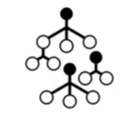
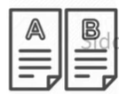
PROCESS
DATA
Model
Train Test Split
DATA
WINE QUALITY PREDICTION
Trained Model

Slide 9
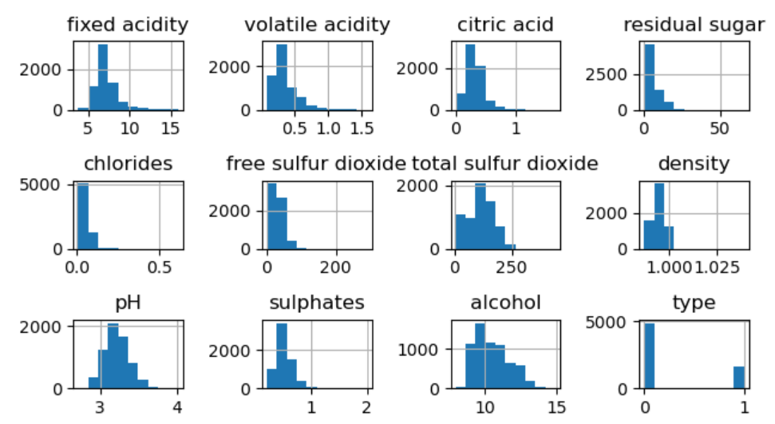
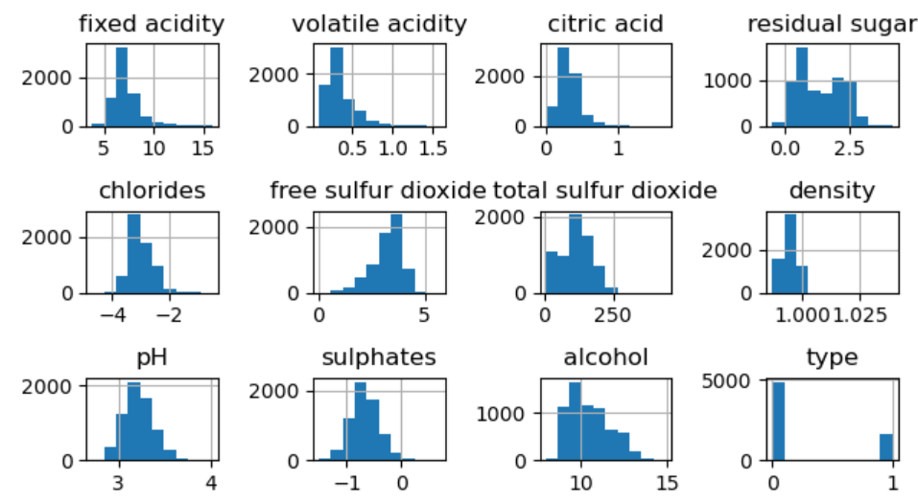
DATA ANALYSIS
Adjusted Skewness

Slide 10
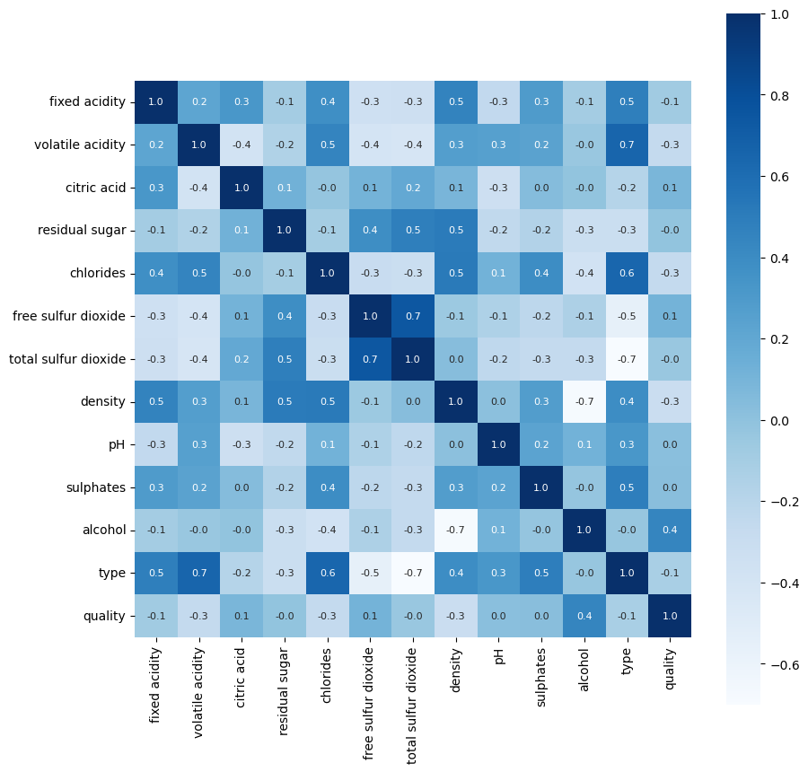
DATA ANALYSIS
Correlation plot

Slide 11
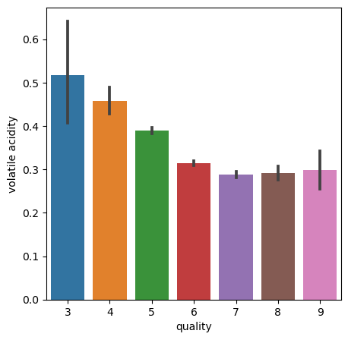
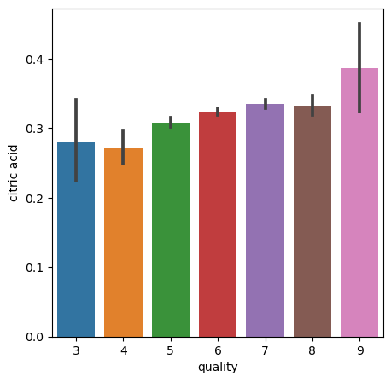
DATA ANALYSIS
Feature V/S Quality

Slide 12
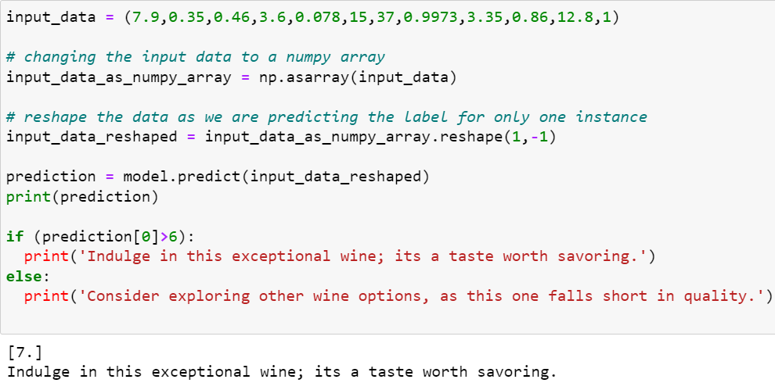
DATA ANALYSIS
Bot

Slide 13
POSSIBLE RECOMENDATIONS
Based on the red wine quality dataset and your analysis, you can conclude with several recommendations that can help improve the quality of red wine. Here are some possible recommendations supported by your analysis:
Acidity Balance: We may advise wine producers to closely monitor the balance of these acidity levels in light of the analysis. Try varying these factors during the winemaking process to determine which combination produces the desired flavor.
Alcohol Content: You might advise matching the alcohol content to the planned style of the wine because different wine types have various alcohol contents.
Evaluation of Quality: Based on the specified characteristics, estimate the wine's quality using the model or analysis you carried out. Use this as a winemaking process quality control measure.
Consistency: Make sure the procedure for manufacturing wine is repeatable and consistent. A solid reputation in the business is frequently built on a foundation of consistent wine quality.

Slide 14
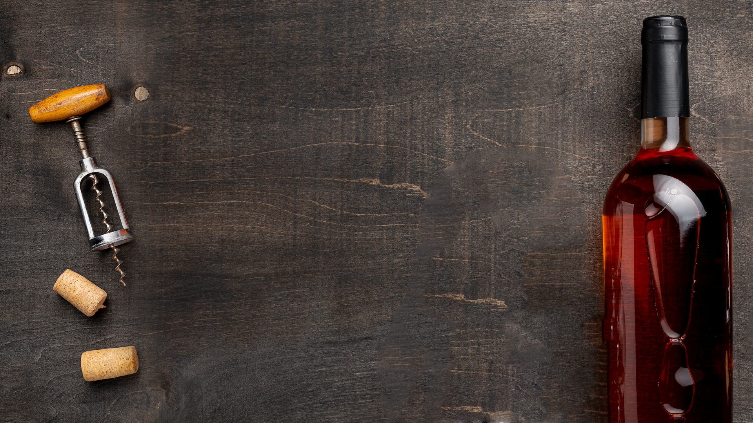
THANK YOU

